Slide 1

TEXTUAL EMOTION RECOGNITION IN VIETNAMESE
Group 3
AI17C
FPT University
Dec 9 2023

Slide 2


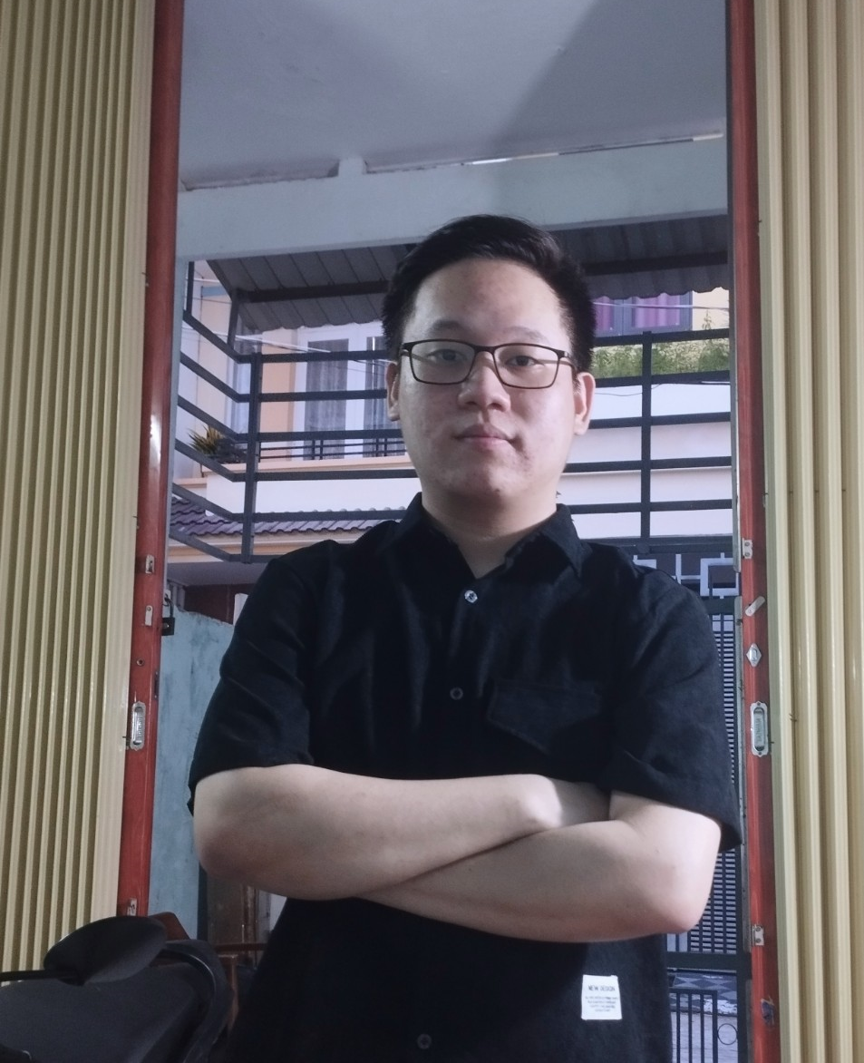
MEMBERS
Ha Khai Hoan
Bui Dinh Thanh Danh
Nguyen Minh Phat

Slide 3

CONTENT
I
PROJECT OVERVIEW
II
IMPLEMENTATION
III
CONCLUSION

Slide 4
I. PROJECT OVERVIEW

Slide 5
PROJECT OVERVIEW
1.1
PROBLEM - PRODUCT
1.2
ASSIGN WORK

Slide 6
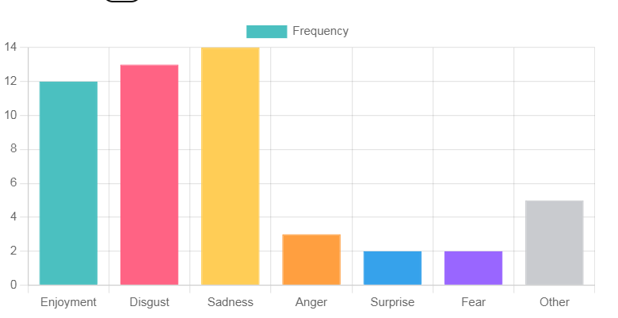



1.1 PROBLEM - PRODUCT
Analyzing people’s opinions has never been an easy task due to their versatility and ambiguity.
“ What do people think about ‘X’? ”
- There are many articles online, difficult to control.
- Through comments and reviews, posts on social networks can be controlled automatically.
- Control comments

Slide 7
1.1 PROBLEM - PRODUCT
ARTIFICIAL INTELLIGENCE SYSTEM CLASSIFIES EMOTIONS IN VIETNAMESE TEXT
Solution:
Use the "Social comment" data set, available on the internet.
Classification:
Enjoyment 😃
Disgust 🤮
Sadness 😭
Anger 😡
Surprise 😯
Fear 😨
Other ❓
Model training
CNN + LSTM
PhoBERT

Slide 8
1.2 ASSIGN WORK
Each person's tasks are not specifically assigned to the entire project but assigned to each stage.
PhoBERT – Minh Phat, Thanh Danh
Spelling – Minh Phat
Model
Data processing
StopWord – Thanh Danh
CNN + LSTM – Khai Hoan
UI – Khai Hoan

Slide 9
II. IMPLEMENTATION

Slide 10
IMPLEMENTATION
2.1
DATA OVERVIEW
2.2
DATA PROCESSING - EVALUATION
2.3
DATA BALANCE
2.4
SUMMARY
2.5
DEMONSTRATION

Slide 11
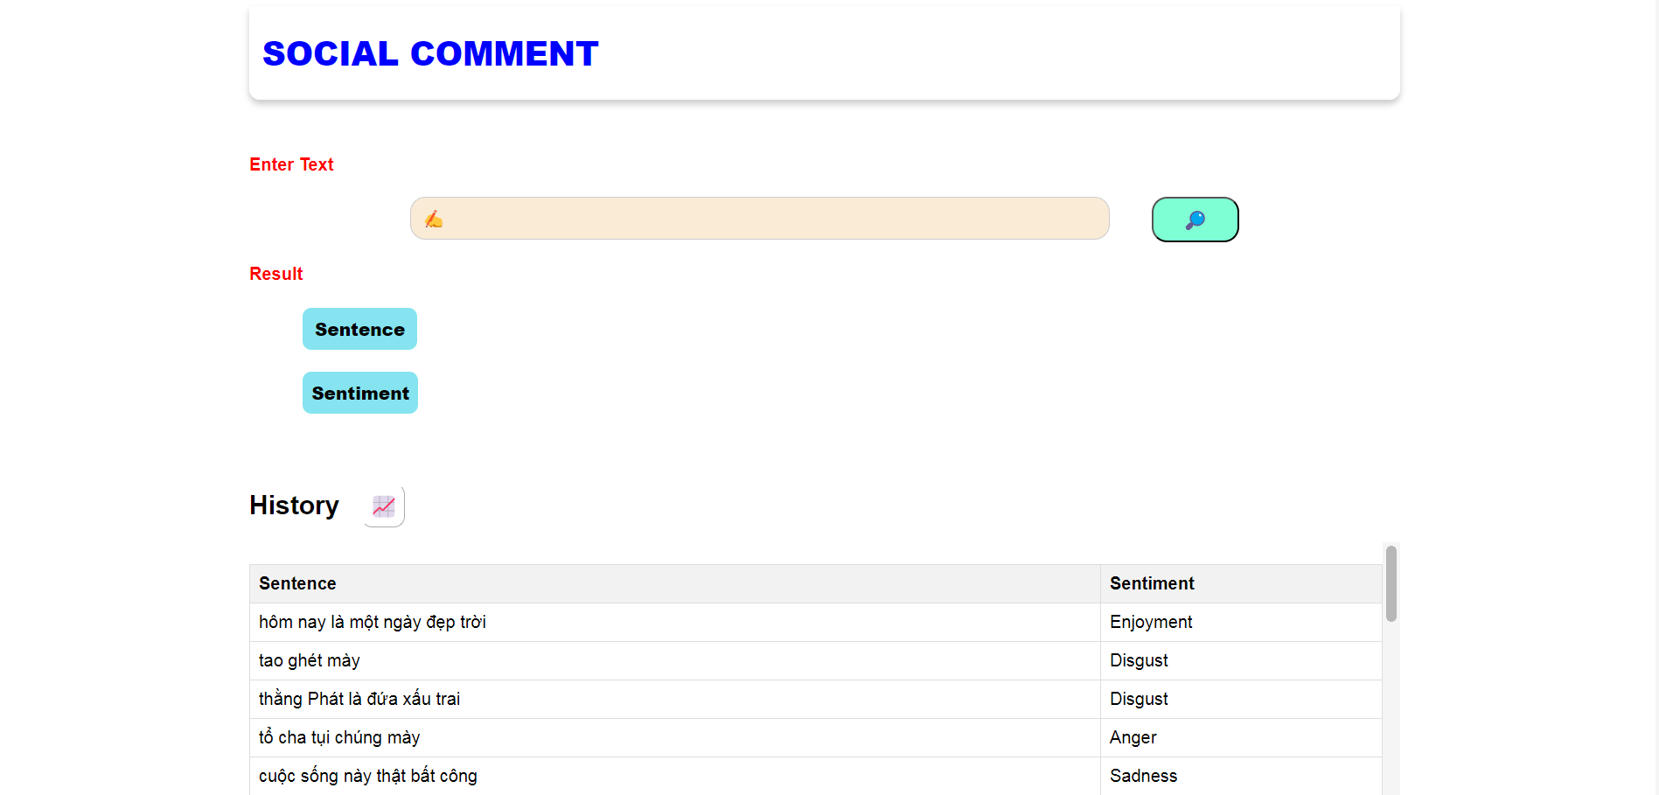

Slide 12
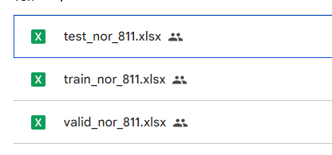
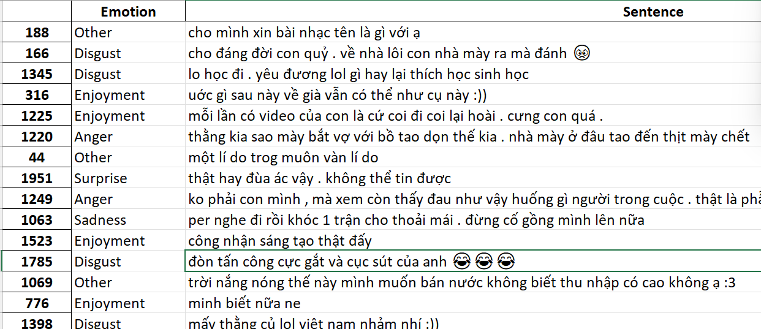
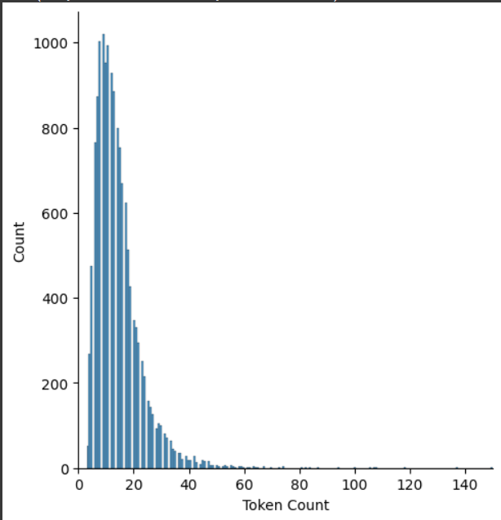
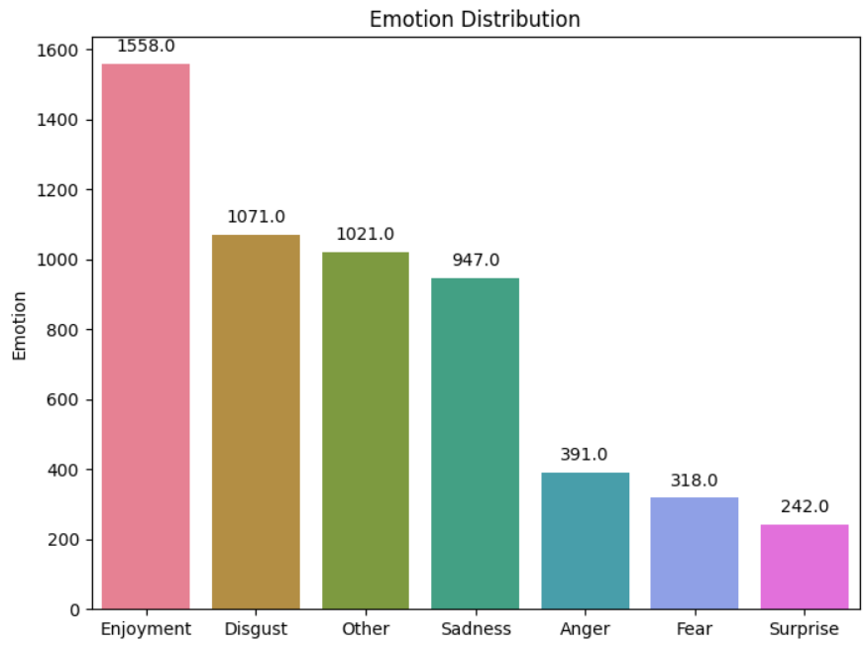

2.1 DATA OVERVIEW
Train set
5548 row

Slide 13
2.2 DATA PROCESSING – AVALUATION
Max-length: 80, epoch 10
CNN + LSTM
(1)
Do not process and put all raw data into the model
(2)
Delete all emoji and special characters
(3)
Handle Emojis, handle Spelling, StopWords and special characters
(4)
Use (3)
Connect words into meaningful compound words
PhoBERT

Slide 14
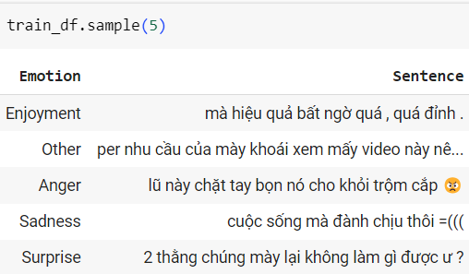

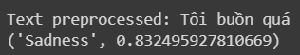
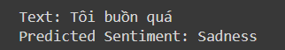
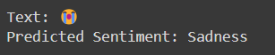
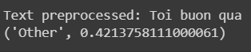
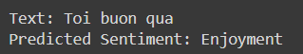
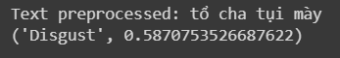
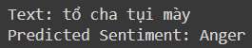
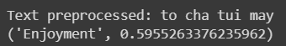
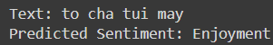
2.2 DATA PROCESSING – AVALUATION
CNN + LSTM
(1)
Do not process and put all raw data into the model
PhoBERT
cô tiên béo quá .. 😅😅 giọng còn the thé nữa .. 😅😅
“cô”, “tiên”, “béo”, “quá”,” ..”, “😅😅”, “giọng”, “còn”, “the”, “thé”, “nữa”, “..”, “😅😅”

Slide 15
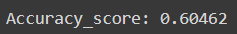
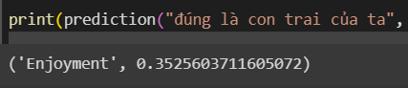
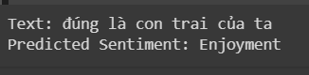
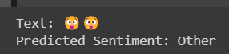
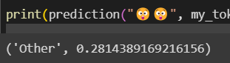
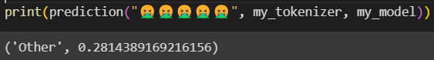
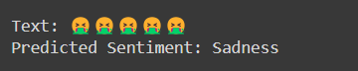
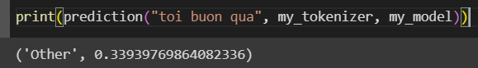
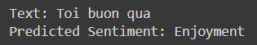
2.2 DATA PROCESSING – AVALUATION
CNN + LSTM
(2)
Delete all emoji and special characters
PhoBERT
cô tiên béo quá .. 😅😅 giọng còn the thé nữa .. 😅😅
cô tiên béo quá giọng còn the thé nữa
“cô”, “tiên”,” béo”, “quá”, “giọng”, “còn” “the”, “thé” ,“nữa”

Slide 16
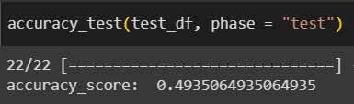

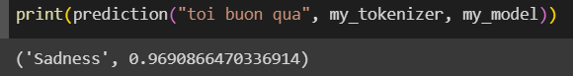
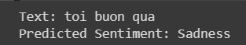
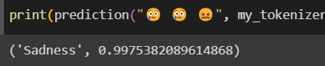
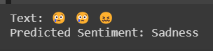
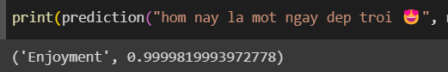
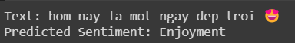
2.2 DATA PROCESSING – AVALUATION
CNN + LSTM
(3)
Handle Emojis, handle Spelling, StopWords and special characters
PhoBERT
Enjoyment 😃,…
Disgust 🤮,…
Sadness 😭,…
Anger 😡,…
Surprise 😯,…
Fear 😨,…
Other remove emoji
StopWords
'chs','cerrrr','aaaaa','aaaaaaa','aamir’
……
Handle Spelling
"trog": "trong", "ne": "nè","thi ch": "thích“,…
Data Augmentation
“đẹp trai thật”
--- “dep trai that”---

Slide 17
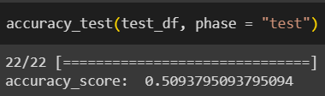
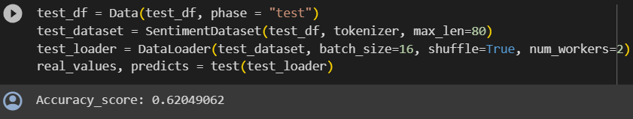
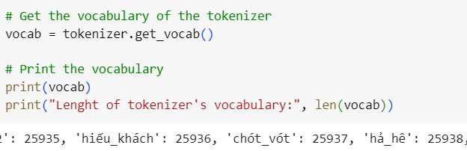
2.2 DATA PROCESSING – AVALUATION
CNN + LSTM
(4)
Use (3)
Connect words into meaningful compound words
PhoBERT
Processing steps are as in (3)
Connect single words into meaningful words
công_ty, hạnh_phúc, gia_đình,…

Slide 18
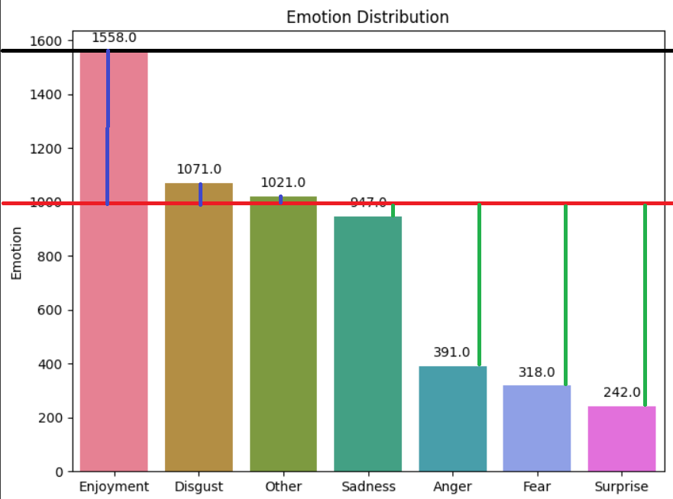
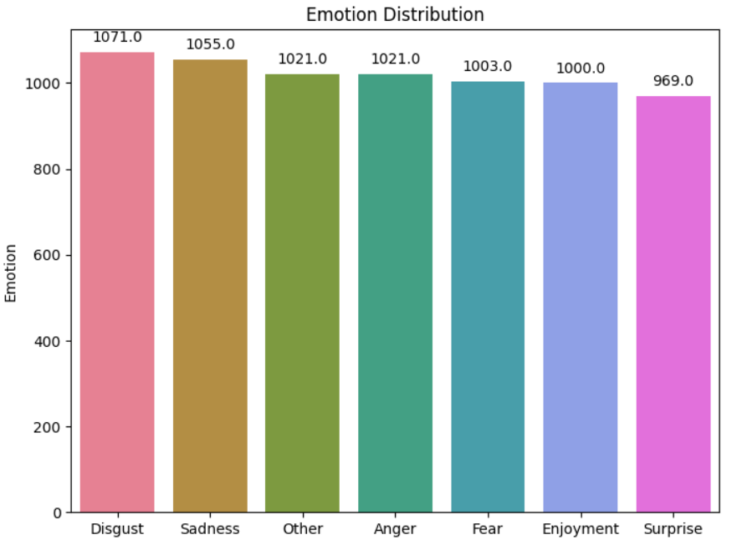
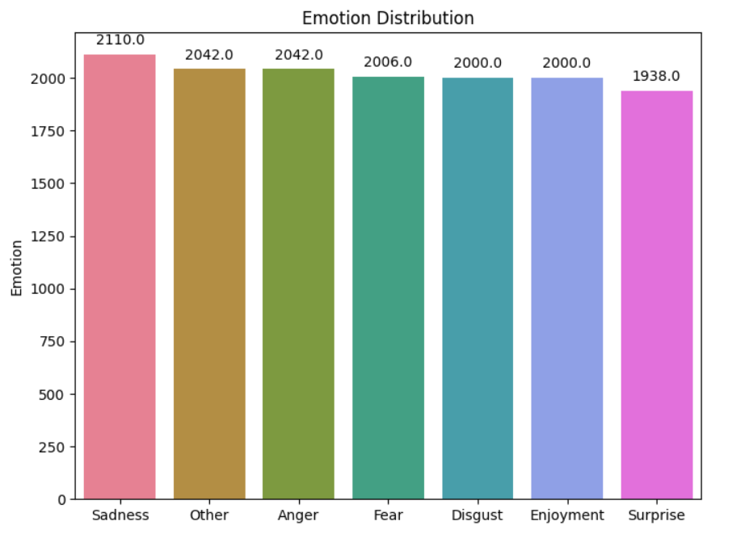
2.3 DATA BALANCE
Data balance
Use ChatGPT to balance data
Data Augmentation

Slide 19
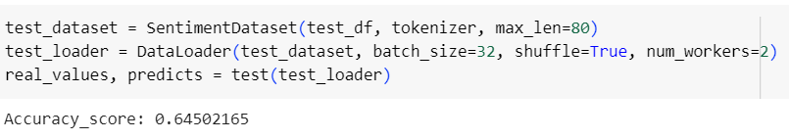
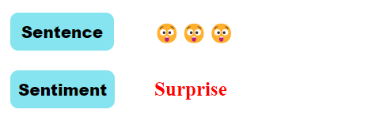
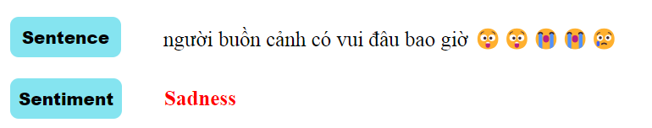
2.3 DATA BALANCE
PhoBERT
Use (4)
Data balance
* Attach the model to the UI

Slide 20
2.4 SUMMARY
CNN + LSTM | 0.46753 | 0.44444 | 0.4935 | 0.5094
PhoBERT | 0.58874 | 0.60462 | 0.6176 | 0.6205 | 0.64502
Data Processing | (1) Do not process and put all raw data into the model | (2) Delete all emoji and special characters | (3) Handle Emojis, handle Spelling, StopWords and special characters, Data augmentation | (4) Use (3) + Connect words into meaningful compound words | (5) Use (4) + Data balance

Slide 21

2.5 DEMONSTRATION

Slide 22
III. CONCLUSION

Slide 23

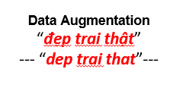

CONCLUSION
Emphasize extremely important data processing in building and training models:
- Data cleaning: remove meaningless words and replace spelling words
- Balance data.
- Data augmentation.

Slide 24
THANK YOU
FOR WATCHING

